Slide 1
Introduction
Università di Modena e Reggio Emilia

Slide 2
Android timeline
2003: Android Inc. was founded
2005: Google bought Android Inc.
2008: first device with Android OS
2017: Google announced that Google Play would begin to require apps to target Android 8
2021: Google announced new apps will need to target Android 10
Name | Internal codename | Version number(s) | Initial stable release date | Supported (security fixes) | API level
Android Oreo | Oatmeal Cookie | 8.0 | August 21, 2017 | No | 26
 |  | 8.1 | December 5, 2017 | No | 27
Android Pie |  | 9 | August 6, 2018 | Yes | 28
Android 10 | Quince Tart | 10 | September 3, 2019 | Yes | 29
Android 11 | Red Velvet Cake | 11 | September 8, 2020 | Yes | 30
Android 12 | Snow Cone | 12 | October 4, 2021 | Yes | 31
Android 12L | Un­known | Un­known | Q1 2022 | Presupported | 32

Slide 3
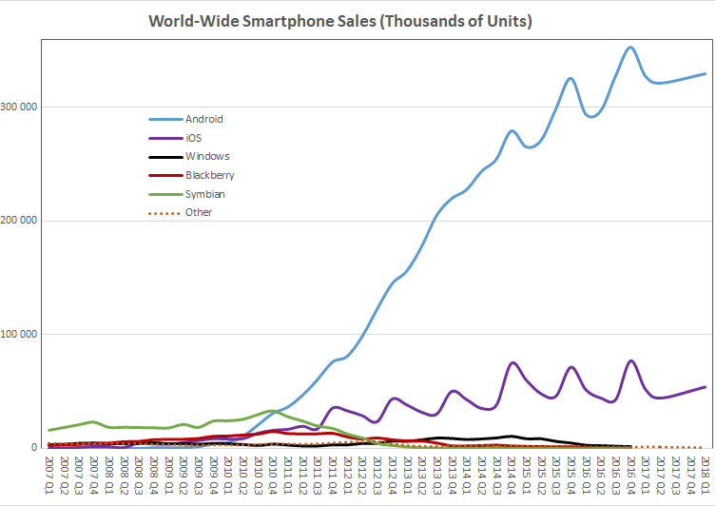
Android stas
Year | Active users
2012 | 0.5 billion
2013 | 0.7 billion
2014 | 1 billion
2015 | 1.4 billion
2016 | 1.7 billion
2017 | 2 billion
2018 | 2.3 billion
2019 | 2.5 billion
2020 | 2.8 billion
https://www.businessofapps.com/data/android-statistics/
https://en.wikipedia.org/wiki/Usage_share_of_operating_systems

Slide 4
Why develop Android app?
Market share
Best-selling OS worldwide on smartphones and tablets
Device compatibility
Low training time
Free and open-source software
Https://source.Android.Com/
Programming languages
You can use Java, Kotlin
Support
Large api

Slide 5
Key features
Linux O.S. Kernel: provide interface with hardware and process control
Run time environment (ART): used to execute applications
(Each app runs in a separate process and ART has control on memory and process management, it could stop or kill processes)
Open source libraries for application development
Pre-installed application: phone, SMS, email, browser, calendar, camera, contacts, alarm clock
Software development kit (SDK): used to create app (including IDE and Documentation)
Application framework to manage system services
User interface framework
Compatibility Definition Document (CDD) and Compatibility Test Suite (CTS): describe the resources required for a devis to support android software

Slide 6
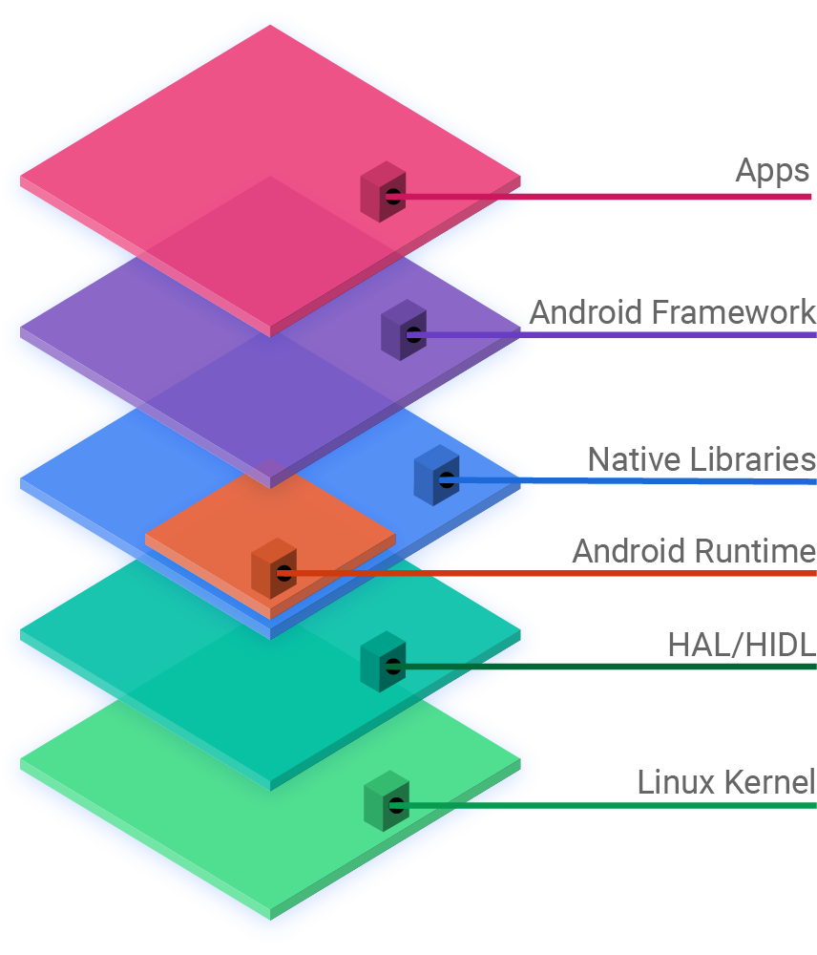
Android Architecture
Android is structured in the form of a software stack
APPS: where is located preinstalled apps and third part apps
ANDROID FRAMEWORK: When you develop android app you use Android Framework, which offer an interface for native languages libraries (Java, C++).
ANDROID RUNTIME: is the android “virtual machine”. Core Libraries is a set of classes which are used by SDK and included functionality near the android VM
HAL (Hardware Abstraction Layer): defines a standard interface for hardware vendors to implement
LINUX KERNEL: Android uses a version of the Linux kernel with a few special additions for a mobile embedded platform. In Linux Kernel each application is binded to a single process

Slide 7
Android Framework
The Android Framework is a set of services that collectively form the environment in which Android applications run and are managed.
Include key services:
Activity Manager: Controls application lifecycle and activity stack.
Content Providers: Allows applications to publish and share data with other applications.
Resource Manager: Provides access to resources
Notifications Manager: Allows applications to display alerts and notifications to the user.
View System: A set of views used to create application user interfaces.
Package Manager: The system by which applications are able to find out information about other applications currently installed on the device.
Telephony Manager: Provides information to the application about the telephony services available on the device such as status and subscriber information.
Location Manager: Provides access to the location services allowing an application to receive updates about location changes.

Slide 8
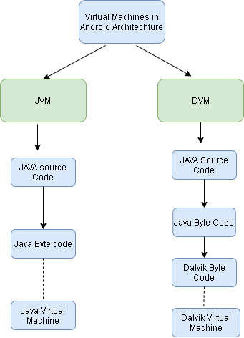
JVM vs Dalvik
Android doesn’t use JVM but use a special VM called DALVIK.
Android devices don’t run .class and .jar files. To improve performance, they use optimized formats.
Android uses DEX Compiler to transform Java Byte code in Dalvik Byte code (.dex)
Since Android 8.0 Dalvik has been replaced by ART (Android Run Time)

Slide 9
Android SDK
Android Software Development Kit contains the libraries and tools you need to develop Android apps
API libraries: one for each Android version
Development tools: Android Studio IDE and other tools (debugger, design tools…)
Android Virtual Device Manager
Emulator: run in AVD
Android support: extra APIs that aren’t available in standard platform
Sample apps: you can find pratical code to help you to use APIs

Slide 10
Android libraries
android.app: Provides access to the application model and is the cornerstone of all Android applications. Contains Activity and Service two of the application core components
android.content: Facilitates content access, publishing and messaging between applications and application components
android.database: Used to access data published by content providers and includes SQLite database management classes.
android.hardware: Presents an API providing access to hardware such as the accelerometer and light sensor.
android.os: Provides applications with access to standard operating system services including messages, system services and inter-process communication.
android.media: Provides classes to enable playback of audio and video.
android.provider: A set of convenience classes that provide access to standard Android content provider databases such as those maintained by the calendar and contact applications.
android.text: Used to render and manipulate text on a device display.
android.widget: A rich collection of pre-built user interface components such as buttons, labels, list views, layout managers, radio buttons etc.
android.view: The fundamental building blocks of application user interfaces.
android.util: A set of utility classes for performing tasks such as string and number conversion, XML handling and date and time manipulation.

